Slide 1
Combinational Circuit
Adders Subtractor Decoder-Encoder
Multiplexers-Demultiplexers Comparator
Parity IC Family

Slide 2
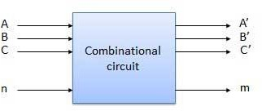
Combinational Circuits
output depends only on the present input
The combinational circuit do not use any memory.
The previous state of input does not have any effect on the present state of the circuit.

Slide 3
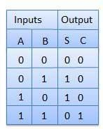

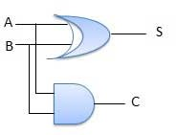
Half Adder
A combinational logic circuit with two inputs and two outputs. The half adder circuit add two single bit Cary number
This circuit has two outputs carry and sum.
S(A, B) = ∑m (1, 2)
CY(A, B) = ∑m (3)

Slide 4
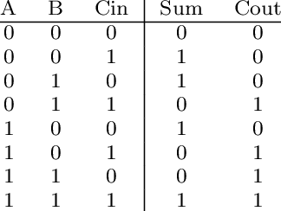
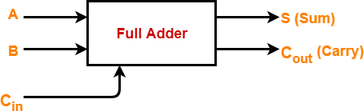
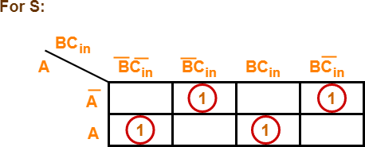
Full Adder (1-bit Adder)
A combinational logic circuit with 3 inputs and 2 outputs.
The Full adder circuit add 3 single bit Cary number This circuit has two outputs carry and sum.
ABC + ABC + ABC + ABC A(BC + BC) + A(BC + BC)
Sum(A, B,C) = ∑m (1, 2, 4, 7)
Cout(A, B, C) = ∑m (3,5,6,7)
A(B ⊕ C) + A(BΘC)
Let B ⊕ C = D
AD + AD
A ⊕ D
A ⊕ B ⊕ C

Slide 5
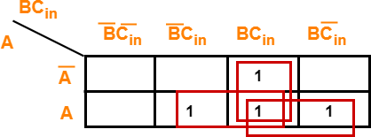
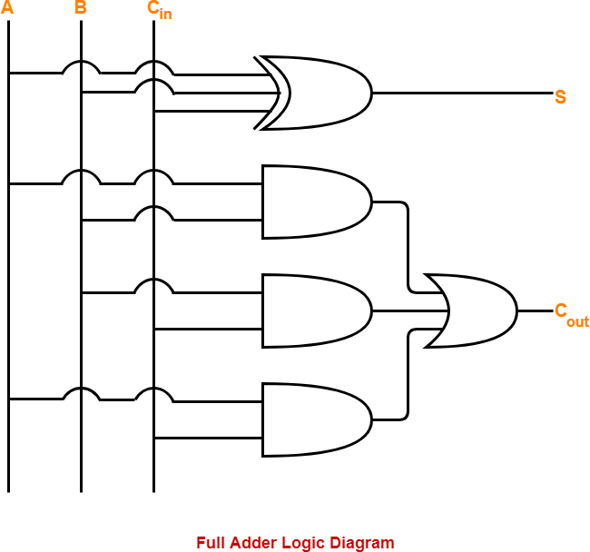
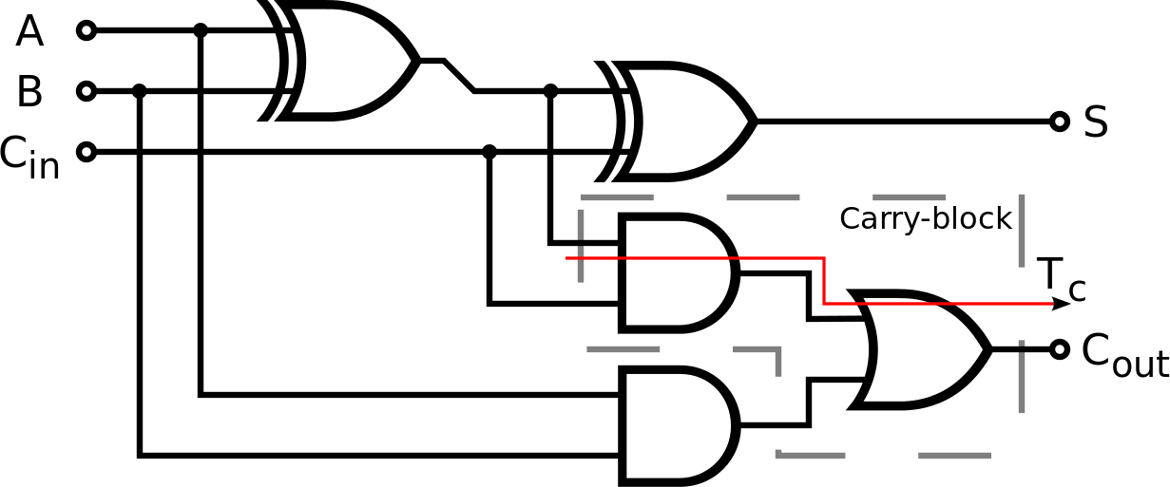
For Cout
ABC + ABC + ABC + ABC C( AB + AB) + AB(C + C) ( A ⊕ B)C + AB
Cout=AB+BC+AC

Slide 6
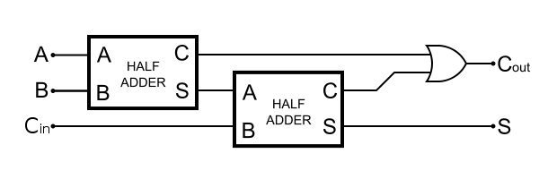
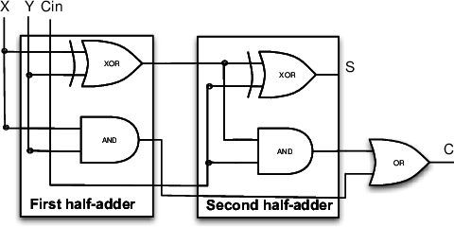
Full Adder using Half Adder
FA
Sum= A⊕B⊕C Carry=AB+(A⊕B)C
HA
Sum= A⊕B
Carry=AB

Slide 7
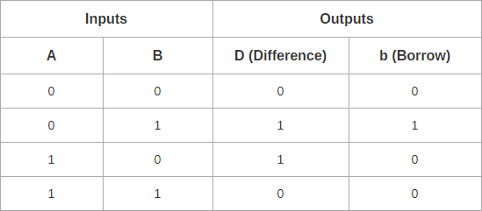
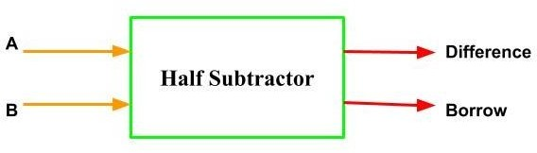
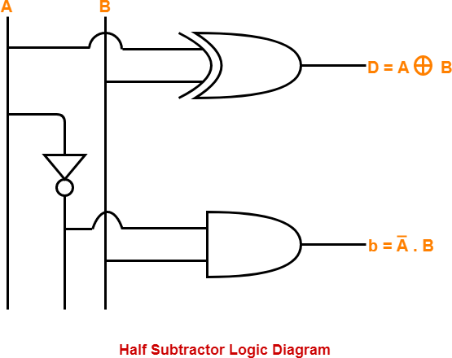
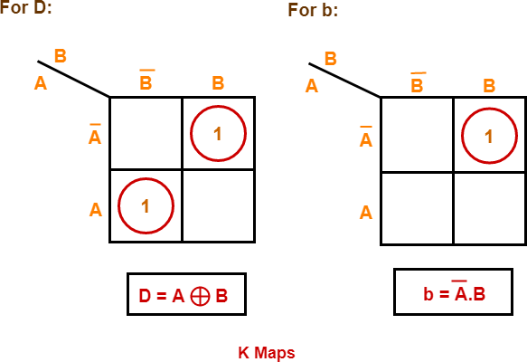
Half Subtractor
Combinational circuit perform binary Subtraction
Accepts 2 input and Two output Difference and Borrow
D(A, B) = ∑m (1, 2)
Br(A, B) = ∑m (1)

Slide 8
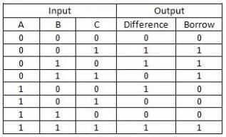
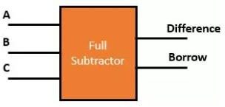
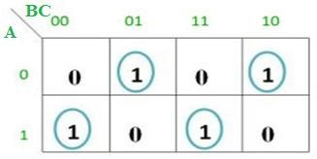
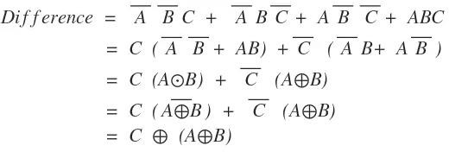
Full Subtractor
Performs subtraction of 3 bits
This circuit has three inputs and two outputs.
The three inputs A, B and C, denote the minuend, subtrahend, and previous borrow, respectively.
The two outputs, D and Bout
Sum(A, B,C) = ∑m (1, 2, 4, 7)
Bout(A, B,C) = ∑m (1,2,3,7)

Slide 9
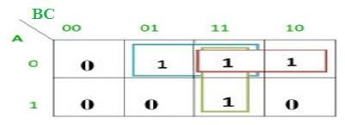

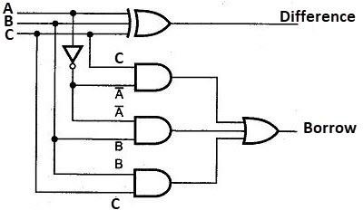
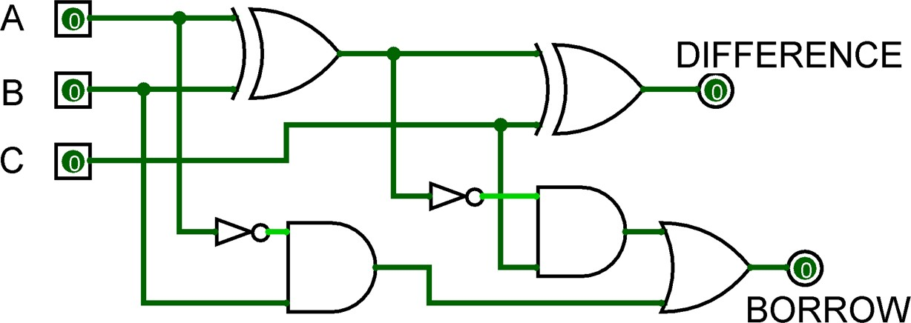
Bout = A’B’C + A’BC’ + A’BC + ABC
= C(AB + A’B’) + A’B(C + C’)
= C( A XNOR B) + A’B
= C (A XOR B)’ + A’B

Slide 10
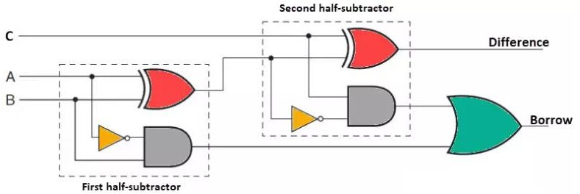
Full Subtractor using Half Subtractor
FS
Sum= A⊕B⊕C Carry=A’B+(A⊕B)’C
HS
Sum= A⊕B Carry=A’B

Slide 11
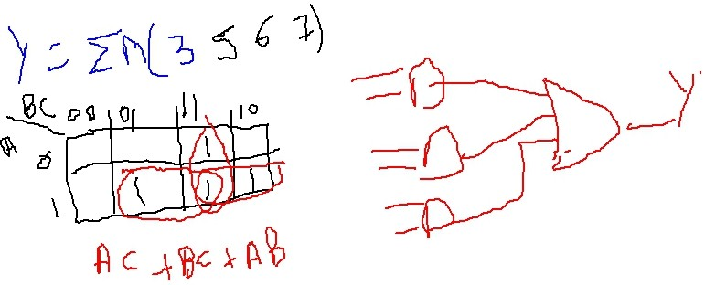
Design a 3 input digital circuit produces high output for two or more binary input high
A | B | C | Y
0 | 0 | 0 | 0
0 | 0 | 1 | 0
0 | 1 | 0 | 0
0 | 1 | 1 | 1
1 | 0 | 0 | 0
1 | 0 | 1 | 1
1 | 1 | 0 | 1
1 | 1 | 1 | 1

Slide 12
Design a 3 input digital circuit produces high output for ODD decimal equivalent
A | B | C | Y
0 | 0 | 0
0 | 0 | 1
0 | 1 | 0
0 | 1 | 1
1 | 0 | 0
1 | 0 | 1
1 | 1 | 0
1 | 1 | 1

Slide 13
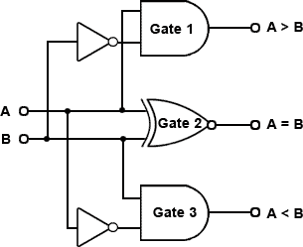
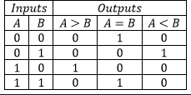
1-BIT Magnitude Comparator
GT EQ LT
1-Bit Magnitude Comparator
A
B
EQ
GT
LT
GT=AB’ EQ=A’B’+AB LT=A’B

Slide 14
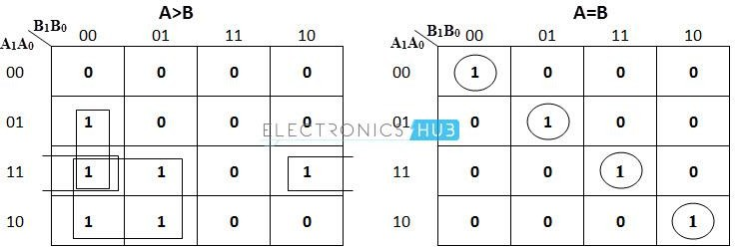
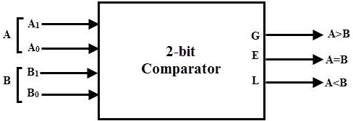
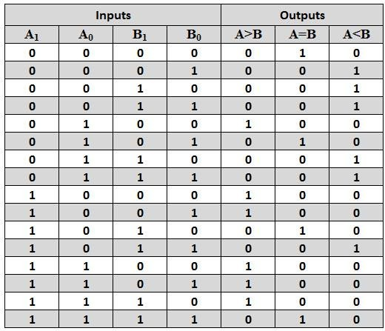
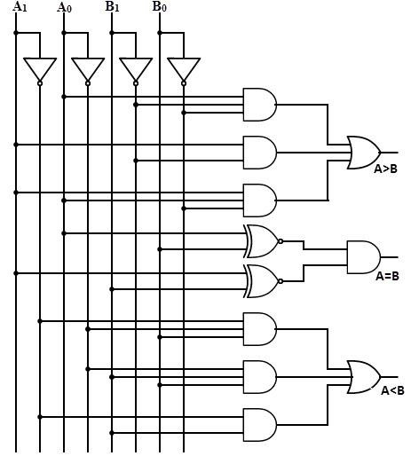
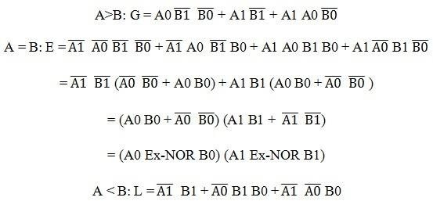
2-BIT Magnitude Comparator

Slide 15
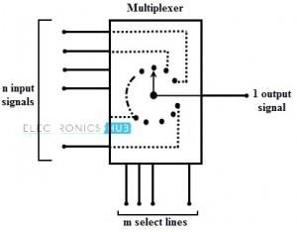
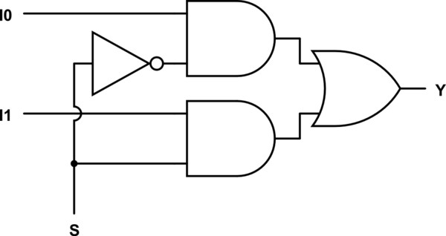
Multiplexer
A combinational circuit has maximum of 2^{n} data inputs, ‘n’ selection lines and single output line.
One of these data inputs will be connected to the output based on the values of selection lines
It is a data selector device
Size of multiplexer is 2^{𝑛}:1
0
2:1 Multiplexer
1
I0
Y
=S’I0 + SI1
I1
S

Slide 16
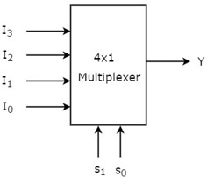
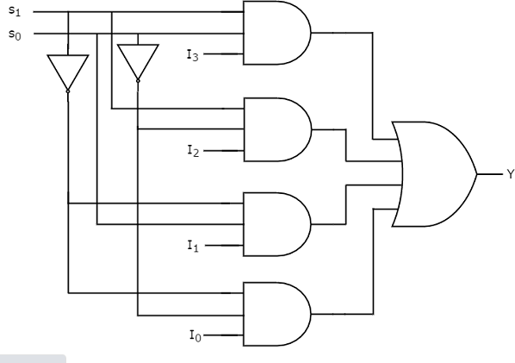
4:1 Multiplexer
Selection Lines |  | Output
S1 | S0 | Y
0 | 0 | I0
0 | 1 | I1
1 | 0 | I2
1 | 1 | I3

Slide 17
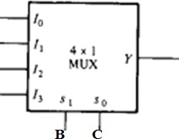
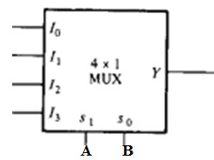
Expression implementation with Multiplexer
Y(A, B,C) = ∑m (1, 3, 5, 6) implement with 4:1 multiplexer Y(A, B,C) = ∑m (1, 2, 4, 5) implement with 4:1 multiplexer
Y = ABC + ABC + ABC + ABC Y = ABC + ABC + ABC + ABC
Any 2 input (AB/BC/AC) select line Any 2 input (AB/BC/AC) select line
0
1
A
A’
C C’ 1
0
Rearrange equation with selection line
Y = 0.(BC) + BC( A + A) + ABC + ABC
I0 I1 I2 I3
Rearrange equation with selection line
Y = ABC + ABC + AB(C + C) + AB.0
I0 I1 I2 I3

Slide 18
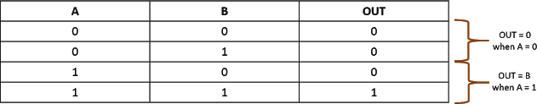
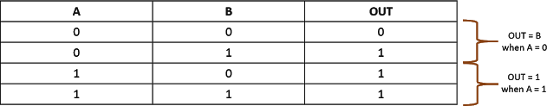
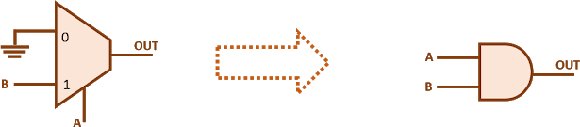
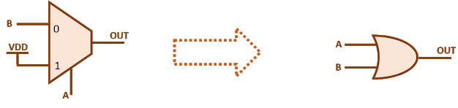


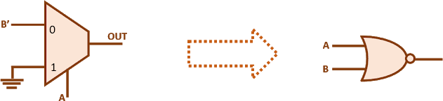
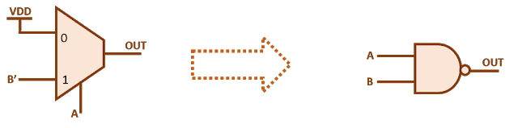
Logic Gate implementation with 2:1 Multiplexer
AND GATE
OR GATE
NOR GATE
NAND GATE

Slide 19
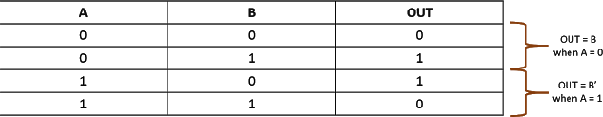

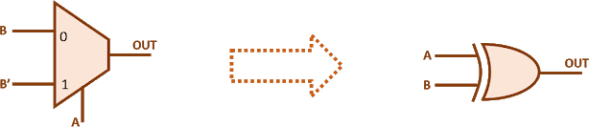
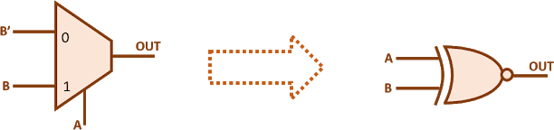
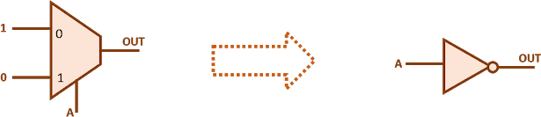

Logic Gate implementation with 2:1 Multiplexer
XOR GATE
XNOR GATE
NOT GATE

Slide 20
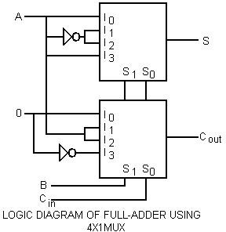
Full Adder implementation with 4:1 Multiplexer
S(A, B, C_{in}) = ∑(1, 2, 4, 7)
= m₁ + m₂ + m₄ +m₇
= A’B’C_{in} + A’BC’_{in} + AB’C’_{in} + ABC_{in}
= A.(B’C’_{in}) + A’.(B’C_{in}) + A’.(BC’_{in}) + A.(B’C’_{in}) (1)
4:1 Mux equation Y = I₀S’₁S’₀ + I₁S’₁S₀ + I₂S₁S’₀ + I₃S₁S₀ (2)
Compare (1) and (2) with S₁ = B, S₀ = C_{in} I₀ = A, I₁ = A’, I₂ = A’, I₃ = A.
C_{out}(A, B, C_{in}) = ∑(3, 5, 6, 7)
= m₃ + m₅ + m₆ + m₇
= A’BC_{in} + AB’C_{in} + ABC’_{in} + ABC_{in}
= (A’ + A) BC_{in} + AB’C_{in} + ABC’_{in} + 0.AB’C’_{in}
= 0.(B’C’_{in}) + A.(B’C_{in}) + A.(BC’_{in}) + 1.(BC_{in})
(3)
4:1 Mux equation Y = I₀S’₁S’₀ + I₁S’₁S₀ + I₂S₁S’₀ + I₃S₁S₀ (4)
Comparing equation (1) and (3) with S₁ = B, S₀ = C_{in}.
I₀ = 0, I₁ = A, I₂ = A, I₃ = 1

Slide 21
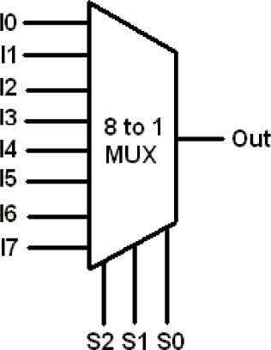
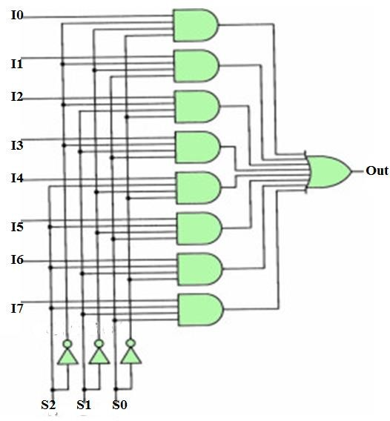
8:1 Multiplexer
S2 | S1 | S0 | Out
0 | 0 | 0 | I0
0 | 0 | 1 | I1
0 | 1 | 0 | I2
0 | 1 | 1 | I3
1 | 0 | 0 | I4
1 | 0 | 1 | I5
1 | 1 | 0 | I6
1 | 1 | 1 | I7
Out=S2’S1’S0’I0 + S2’S1’S0I1+ S2’S1S0’I2+ S2’S1S0I3 S2S1’S0’I4+ S2S1’S0I5+ S2S1S0’I6+ S2S1S0I7

Slide 22

Full adder using 8:1 Mux
S(A, B, C_{in}) = ∑(1, 2, 4, 7)
C_{out}(A, B, C_{in}) = ∑(3, 5, 6, 7)
High input for present minterm, low input
for minterm not present

Slide 23


Slide 24



4:1 Mux using 2:1 Mux
8:1 Mux using 4:1 and 2:1 Mux
S1 (MSB) | S0(LSB) | Out
0 | 0 | I0
0 | 1 | I1
1 | 0 | 12
1 | 1 | I3

Slide 25


Demultiplexer
switch one common input line to one of several output line based on select input It is data distributor
Size of demux 1:2^{𝑛} Example 1:4, 1:8, 1:16….. Demultiplexer
Selection Inputs |  | Outputs
S1 | S0 | Y3 | Y2 | Y1 | Y0
0 | 0 | 0 | 0 | 0 | I
0 | 1 | 0 | 0 | I | 0
1 | 0 | 0 | I | 0 | 0
1 | 1 | I | 0 | 0 | 0

Slide 26



Decoder
A combinational circuit that has ‘n’ input lines and maximum of 2^{n} output lines.
One of these outputs will be active High based on the combination of inputs present, when the decoder is enabled. The outputs of the decoder are min terms of ‘n’ input variables lines when it is enabled
Size of Decoder are 2:4, 3:8, 4:16….
A1 | A0 | Y3 | Y2 | Y1 | Y0
0 | 0 | 0 | 0 | 0 | 1
0 | 1 | 0 | 0 | 1 | 0
1 | 0 | 0 | 1 | 0 | 0
1 | 1 | 1 | 0 | 0 | 0

Slide 27


Full Adder using 3:8 Decoder
Full Subtractor using 3:8 Decoder
S = A’B’C + A’BC’ + AB’C’ + ABC = Σ(1,2,4,7) CY = A’BC +AB’C +ABC’+ABC= Σ (3, 5, 6, 7)
DIFFERENCE = A’B’C + A’BC’ + AB’C’ + ABC = Σ(1,2,4,7) BORROW = A’B’C +A’BC’ +A’BC+ABC= Σ (1, 2, 3, 7)
Y

Slide 28


3:8 decoder using 2:4 decoder
Decoder with Enable
One of outputs will be ‘1’ when enable, E is ‘1’
A2 | A1 | A0 | HIGH OUTPUT
0 | 0 | 0 | Y0
0 | 0 | 1 | Y1
0 | 1 | 0 | Y2
0 | 1 | 1 | Y3
1 | 0 | 0 | Y4
1 | 0 | 1 | Y5
1 | 1 | 0 | Y6
1 | 1 | 1 | Y7

Slide 29
4:16 decoder
A3 | A2 | A1 | A0 | HIGH OUTPUT
0 | 0 | 0 | 0 | Y0
0 | 0 | 0 | 1 | Y1
0 | 0 | 1 | 0 | Y2
0 | 0 | 1 | 1 | Y3
0 | 1 | 0 | 0 | Y4
0 | 1 | 0 | 1 | Y5
0 | 1 | 1 | 0 | Y6
0 | 1 | 1 | 1 | Y7
1 | 0 | 0 | 0 | Y8
1 | 0 | 0 | 1 | Y9
1 | 0 | 1 | 0 | Y10
1 | 0 | 1 | 1 | Y11
1 | 1 | 0 | 0 | Y12
1 | 1 | 0 | 1 | Y13
1 | 1 | 1 | 0 | Y14
1 | 1 | 1 | 1 | Y15
Y0
A3
A2
4:16 Decoder
A1
A0
Y15
EN

Slide 30

4:16 decoder using 3:8 decoder
A3 | A2 | A1 | A0 | HIGH OUTPUT
0 | 0 | 0 | 0 | Y0
0 | 0 | 0 | 1 | Y1
0 | 0 | 1 | 0 | Y2
0 | 0 | 1 | 1 | Y3
0 | 1 | 0 | 0 | Y4
0 | 1 | 0 | 1 | Y5
0 | 1 | 1 | 0 | Y6
0 | 1 | 1 | 1 | Y7
1 | 0 | 0 | 0 | Y8
1 | 0 | 0 | 1 | Y9
1 | 0 | 1 | 0 | Y10
1 | 0 | 1 | 1 | Y11
1 | 1 | 0 | 0 | Y12
1 | 1 | 0 | 1 | Y13
1 | 1 | 1 | 0 | Y14
1 | 1 | 1 | 1 | Y15

Slide 31

4:16 decoder using 2:4 decoder
A3
 | A2 | A1 | A0 | HIGH OUTPUT
0 | 0 | 0 | 0 | Y0
0 | 0 | 0 | 1 | Y1
0 | 0 | 1 | 0 | Y2
0 | 0 | 1 | 1 | Y3
0 | 1 | 0 | 0 | Y4
0 | 1 | 0 | 1 | Y5
0 | 1 | 1 | 0 | Y6
0 | 1 | 1 | 1 | Y7
1 | 0 | 0 | 0 | Y8
1 | 0 | 0 | 1 | Y9
1 | 0 | 1 | 0 | Y10
1 | 0 | 1 | 1 | Y11
1 | 1 | 0 | 0 | Y12
1 | 1 | 0 | 1 | Y13
1 | 1 | 1 | 0 | Y14
1 | 1 | 1 | 1 | Y15

Slide 32



4:2 Encoder

Slide 33


4-bit Ripple Carry Adder

Slide 34

4-bit Adder cum Subtractor
capable of both addition and subtraction of
binary numbers in one circuit
K=0 Addition K=1 Subtraction
For K=0: S=A+B
A(A3A2A1A0)=0010→2 and B(B3B2B1B0)=0011→3
B0(exor)K=B0 and Cin=K=0
First full adder=A0+B0+Cin=0+1+0,S0=1 C0=0 Second full adder=A1+B1+C0=1+1+0,S1=0 C1=1
Third full adder=A2+B2+C1=0+0+1=1,S2=1 C2=0 Fourth full adder=A3+B3+C2=0+0+0=0,S3=0 Cout=0
S(S3S2S1S0) = 0101 ➔ 5
For K=1: S=A-B
A(A3A2A1A0)=0010→2 and B(B3B2B1B0)=0011→3
B0(exor)K=~B0, B1(exor)K=~B1, B2(exor)K=~B2,
B3(exor)K=~B3 and Cin=K=1
First full adder=A0+B0+Cin=0+0+1,S0=1 C0=0 Second full adder=A1+B1+C0=1+0+1=0,S1=1 C1=0
Third full adder=A2+B2+C1=0+1+0=1,S2=1 C2=0
Fourth full adder=A3+B3+C2=0+1+0=0,S3=1 Cout=0
S(S3S2S1S0)=1111;Cout=0 2’s compliment=0001➔-1

Slide 35



ity Generator Circuit
Even Parity Generator ^{Par} If odd number of ones present in the input, then even parity bit, P should be ‘1’ so that the resultant word contains even number of ones.
Binary Input WXY | Even Parity bit P
000 | 0
001 | 1
010 | 1
011 | 0
100 | 1
101 | 0
110 | 0
111 | 1
 | Odd Parity Generator If even number of ones present in the input, then odd parity bit, P should be ‘1’ so that the resultant word contains odd number of ones
Binary Input WXY |  | Odd Parity bit P
000 |  | 1
001 |  | 0
010 |  | 0
011 |  | 1
100 |  | 0
101 |  | 1
110 |  | 1
111 |  | 0

Slide 36



Parity Checker Circuit
Even parity checker checks error in the transmitted data, which contains message bits along with even parity.

Slide 37
IC Families
Logic family are digital integrated circuit devices which are constructed with a combination of electronic gates.
A family has its own power supply voltage and group potential; distinct logic levels.
Diode Logic (DL)
Resistor-Transistor Logic (RTL)
Diode-Transistor Logic (DTL)
Transistor-Transistor Logic (TTL)
logic is implemented with the use of resistors and diodes. logic is implemented with the use of transistors and resistors logic is implemented with the use of diodes and transistors. logic are implemented with transistors
Emitter Coupled Logic (ECL) logic are implemented with transistors
Complementary Metal Oxide Semiconductor Logic (CMOS) logic are implemented with MOSFET

Slide 38

Fan out: It specifies the number of standard loads that the output of the gate can drive without affecting its normal operation.
Fan in: This is the number of inputs of a logic gate.
Power Dissipation: This is the power supplied required to operate the gate.
Propagation delay Time delay between the occurrence of change in the logical level at the input and before it is reflected at
the output
Noise margin: This is the maximum noise voltage added to the input signal of digital circuit that does not cause an undesirable change in the circuit output

